Slide 1
Group no :- 5 Microsoft Office SharePoint server 2007
Members: Deva Mishra :- 44 Aman Gupta :- 17 Abhishek Gupta :- 16 Suraj Gupta :- 24 Ashish Jaiswal :- 26 Shital Chaube :- 05
Sumit Gupta :- 23 Puja Gupta :- 21 Brijesh Chaudhary :- 06

Slide 2
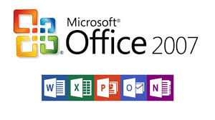
What is Microsoft Office 2007 ?
Microsoft Office 2007 is a version of Microsoft office, a family of office suites and productivity software for windows, developed and published by Microsoft.

Slide 3
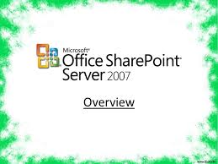
Introduction to Microsoft Office SharePoint Server 2007
Microsoft Office SharePoint server or (MOSS) is Microsoft’s first integrated server platform that aims to provide web content management, enterprise content services, and enterprise search.
MOSS 2007 is an application which runs on the WSS 3.0 platform.

Slide 4
Introduction to Microsoft Office SharePoint Server 2007
SharePoint is a massive website engine which helps you create your own web site.
It is not necessary to be a web designer for creating a website , any SharePoint user can create their own sites which can be a personal site or a website for their team or a website for their company as well as world.
MOSS 2007 is enterprise collaboration and portal application which sits on top of WSS 3.0 framework and extends WSS 3.0 features as well as provides several new features which are not available in core WSS 3.0.
It is used by Organizations to create websites .
It can be use as a secure place to store , organise, share, and access information from any device.

Slide 5
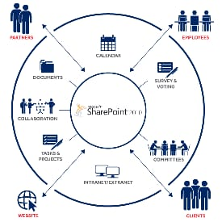
General Improvements:-
1 ) Navigation:- Navigation can make or break your website’s overall performance when it comes to retaining visitors, keeping them engaged and driving them through the conversion funnel.
2) Breadcrumd:- A breadcrumb trail is a small menu usually located at the top of a page, used as a navigational aid. It shows the path to go from the current page back to the homepage.

Slide 6
General Improvements:-
3) Improved views :- Many professionals have areas of improvement that could affect the way they work. Knowing what you can enhance can help you develop a plan of action to work on addressing your weaknesses, which can help you become a better employee.
4) Item level security:- Here is a real-life scenario. You have built a list in SharePoint so that users can submit entries, but you only want users to be able to read or modify own entries.
5) Security trimmed ui:- The assembly Microsoft.SharePoint.WebControls contains a control named SPSecurityTrimmedControl that does the security trimming of the child controls inside it. Just include our control inside this control and it will be displayed or hidden based on the permission specified.
6) RSS:- The RSS chief's statement saw the civil aviation ministry swing into damage control mode. The ministry has assiduously worked over the past 10 months to offload its majority stake in the airline, but has struggled to find buyers.

Slide 7
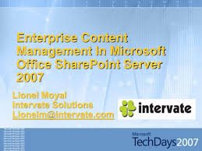
Content Management
Bootstrap -- Architecture Basics:- To really get the most out of SharePoint you need to understand several important design and architecture concepts, and plan your implementation with a few key points in mind.

Slide 8
Content Management
Second Things Next -- User Experience and IA:- Don’t ask SharePoint to help you with your User Experience or Information Architecture. MOSS is a .NET development platform which provides a set of content, collaboration, search and integration services.
Look and Feel -- Branding & Navigation:- If you listen to all the gossip on the net you may have heard that modifying the branding of a SharePoint site is one of the most challenging aspects of building on SharePoint.
Creating Multi-Lingual Websites:- SharePoint is able to create and deploy websites that are multi-lingual. SharePoint has a feature called Variations that can be used to deploy content in one or more languages.
Publishing & Deployment:- Setting up a SharePoint site requires setting up several site infrastructures -- generally development, staging and production.
Wrap Up -- Time to Get Dirty:- That’s the basics of web content management in SharePoint 2007. Us per the usual story, the best way to really understand the technology is to get your hands dirty with it.

Slide 9
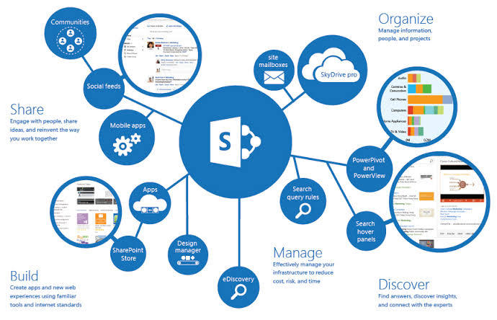
Benefits
Provides :- Microsoft Office SharePoint Server 2007 provides a simple, familiar, and consistent user experience tightly integrated with familiar desktop applications, e-mails, and Web browsers.
Boost Productivity :- Microsoft Office SharePoint Server 2007 boosts productivity by simplifying everyday business activities through out-of-the-box workflows.

Slide 10
Benefits
Connect People:- Office SharePoint Server connects people with information and expertise through a powerful and relevant search.
Business-Critical:- Microsoft SharePoint Server 2007 enables people to make better-informed decisions by presenting business-critical information in one central location.
Sharing Business data:- Microsoft Office SharePoint Server 2007 allows sharing business data without divulging sensitive information through real time, interactive Excel spreadsheets using Excel Services.
organize access:- Microsoft Office SharePoint Server 2007 simplifies organization-wide access to both structured and unstructured information across disparate systems including Enterprise Resource Planning and CRM applications.

Slide 11
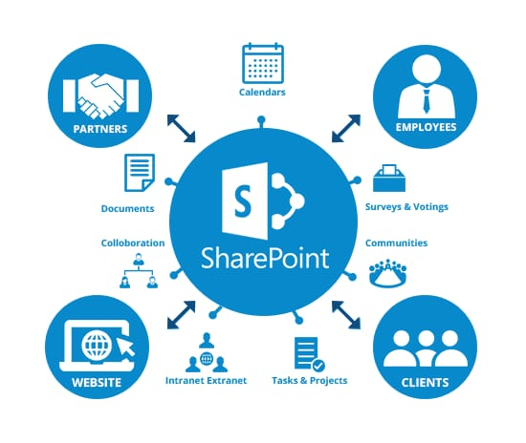
CRITICISM OF MICROSOFT OFFICE SHAREPOINT SERVER 2007
Bibliographies:- The new word 2007 features for bibliographies only support a small number of fixed citation style. Using XSLT, new styles can be added.The standard Association for computing Machinery publication format,are made freely available by third parties.

Slide 12
CRITICISM OF MICROSOFT OFFICE SHAREPOINT SERVER 2007
Office open XML:- The new XML-based document file format in Microsoft Office 2007 is incompatible with previous version Microsoft Office unless an add on is installed for the older version. The Microsoft Word 2007 file format usability for does not support open XML format.
Ribbons:-Even though the ribbon can be hidden PC World wrote that the new ribbon interface crowds the Office work area, especially for notebook users. PC World has stated that upgrading to Office 2007 presents dangers to certain data, such as templates, macros, and mail messages.
The ribbon cannot be moved from the top to the side of the page.
Patenting controversy:- Microsoft contractor Mike Gunderloy left Microsoft partially over his disagreement With the company’s. He says that by leaving Microsoft , he is “no longer contributing death of programing”.

Slide 13
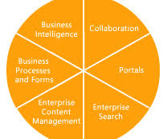
Six Pillars of Microsoft SharePoint Server 2007
1.Collaboration : - By integrating Workspaces, Tasks, Forums, Surveys, Blogs, RSS and Wikis, the platform builds on the wild success of the 2003 collaboration features while hitting the Web 2.0 check box items for the new wave of collaboration and knowledge management applications.

Slide 14
Six Pillars of Microsoft SharePoint Server 2007
2 Portal : SharePoint is a portal framework built using multiple portlets known as web parts. It offers Master pages which can be used for maintaining consistency across the portal.
This remains one of the primary differentiators between the pay per CAL SharePoint version and the free WSS offering.
3. Enterprise Search :- The core problems have been addressed and the functionality broadly expanded.
MOSS 2007 opens up ACL-aware search across both local and remote data stores with features that enable specialized search for people and expertise.
The ability to index and search data in line-of-business apps via the Business Data Store integration is powerful and will please both business managers and developers alike.

Slide 15
Six Pillers of Microsoft SharePoint Server 2007
4.web & enterprise content management :- rolMicrosoft is including core document management , major and minor versioning,check-in/check-out document locking, rich descriptive metadata, workflow (via windows workflow foundation),content type-based policies, auditing, and e- based -access controls at the document library ,folder, and individual document levels .
The 2007 release builds on these capabilities delivering enhanced authoring, business document processing, web content management and publishing, records management.
5. Business process :- Microsoft has overhauled this aspect of sharepoint with XML driven infopath forms that are available on a variety of platforms including portable wireless devices.

Slide 16
Six Pillers of Microsoft SharePoint Server 2007
Client/server based form maintenance has been centralized and improved for business, processes for partner and customers .this area is not as close to our hears, but is another dynamic one that captures attention.
6. Business Intelligence :- finally, BI has been improved across the board with Web-based dashboards on the macro level, server-based Excel services and Excel web services API's, line of business application and data repository application and data repository integration, and more sophisticated abilities to monitor key performance indicators.

Slide 17

Development of MOSS
Office 2007 introduced a new graphical user interface called the Fluent User Interface, which uses ribbons and an Office menu instead of menu bars and toolbars. Office 2007 also introduced Office Open XML file formats as the default file formats in Excel, PowerPoint, and Word. The new formats are intended to facilitate the sharing of information between programs, improve security, reduce the size of documents, and enable new recovery scenarios

Slide 18
Development of MOSS
Office 2007 requires Windows XP with Service Pack 2, Windows Server 2003 with Service Pack 1, or a later version of Windows; it is the last version of Microsoft Office to run on Windows XP Professional x64 Edition, as well as the x64 editions of Windows Server 2003
Microsoft FrontPage discontinued, Microsoft SharePoint Designer, which is aimed towards development of SharePoint portals, becomes part of the Office 2007 family. Its designer-oriented counterpart, Microsoft Expression Web, is targeted for general web development. However, neither application has been included in Office 2007 software suites.
Speech recognition functionality has been removed from the individual programs in the Office 2007 suite, as Windows Speech Recognition was integrated into Windows Vista. Windows XP users must install a previous version of Office to use speech recognition features.

Slide 19
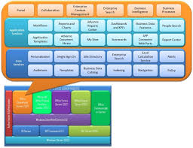
Features of MOSS
1. User interface (UI);- The entire user interface has been redesigned to make navigation and achieving simple tasks easy.

Slide 20
Features of MOSS
2. Drag and drop:- Upload content to sites by dragging items from your computer into a library.
3. On-hover:- A callout feature that works with any document within a library or from search results that enables easy sharing, viewing, following or jumping to content.
4.Touch:- Large touch targets for easy navigation and mobile device access.
5. Business Intelligence :- finally, BI has been improved across the board with Web-based dashboards on the macro level, server-based Excel services and Excel web services API's, line of business application and data repository application and data repository integration, and more sophisticated abilities to monitor key performance indicators.
Despite Microsoft's performance point BI server, this is one area of MOSS that we feel has the ability to shift the market.

Slide 21
Thank you

